Slide 1
Introducing routing
Routing is the process that a router uses to forward packets toward the destination network.
A router makes decisions based upon the destination IP address of a packet.
In order to make the correct decisions, routers must learn the direction to remote networks.

Slide 2
When routers use dynamic routing, this information is learned from other routers.
When static routing is used, a network administrator configures information about remote networks manually.

Slide 3
Static route operation
Static route operations can be divided into these three parts:
  Network administrator configures the route
  Router installs the route in the routing table
  Packets are routed using the static route
Since a static route is manually configured, the administrator must configure the static route on the router using the ip route command.

Slide 4
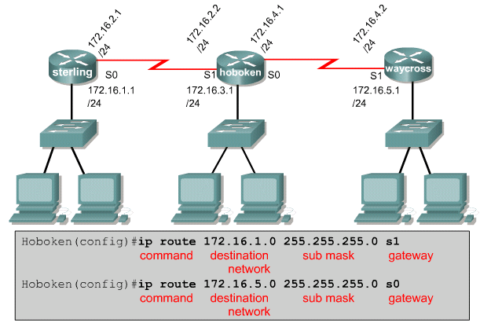

Slide 5
If the router cannot reach the outgoing interface that is being used in the route, the route will not be installed in the routing table.
This means if that interface is down, the route will not be placed in the routing table.

Slide 6
Sometimes static routes are used for backup purposes.
A static route can be configured on a router that will only be used when the dynamically learned route has failed.

Slide 7
Configuring static routes
Use the following steps to configure static routes:
  Determine all desired destination networks, their subnet masks, and their gateways. A gateway can be either a local interface or a next hop address that leads to the desired destination.
  Enter global configuration mode.
  Type the ip route command with a destination address and subnet mask followed by their corresponding gateway from Step one. Including an administrative distance is optional.

Slide 8
  Repeat Step three for as many destination networks as were defined in Step one.
  Exit global configuration mode.
  Save the active configuration to NVRAM by using the copy running-config startup-config command.

Slide 9
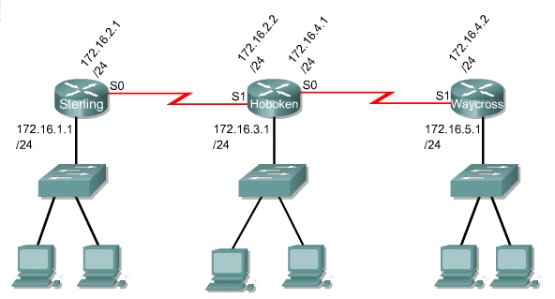

Slide 10
Configuring default route forwarding
Default routes are used to route packets with destinations that do not match any of the other routes in the routing table.
A default route is actually a special static route that uses this format:
    ip route 0.0.0.0 0.0.0.0 [next-hop-address | outgoing interface]

Slide 11
Use the following steps to configure default routes:
  Enter global configuration mode.
  Type the ip route command with 0.0.0.0 for the destination network address and 0.0.0.0 for the subnet mask. The gateway for the default route can be either the local router interface that connects to the outside networks or the IP address of the next-hop router.
  Exit global configuration mode.
  Save the active configuration to NVRAM by using the copy running-config startup-config command.

Slide 12
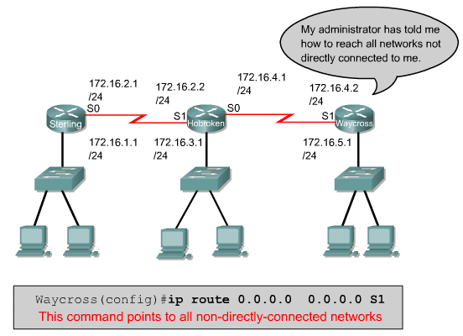

Slide 13
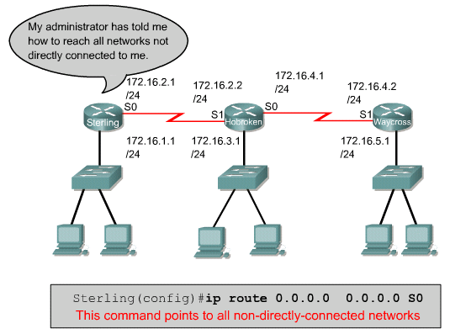

Slide 14
Verifying static route configuration
Use the following steps to verify static route configuration:
  In privileged mode enter the command show running-config to view the active configuration.
  Verify that the static route has been correctly entered.
  Enter the command show ip route.
  Verify that the route that was configured is in the routing table.

Slide 15
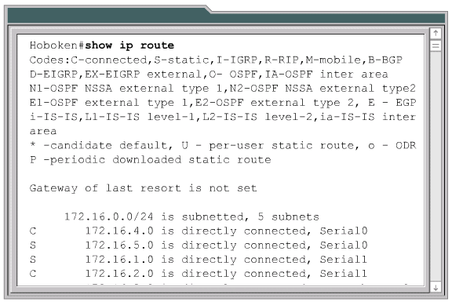
Troubleshooting static route configuration

Slide 16
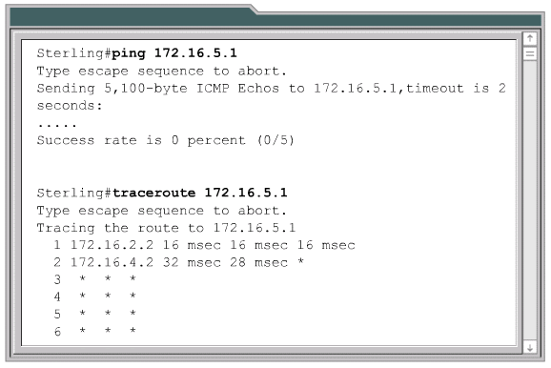

Slide 17
Introduction to routing protocols
A routing protocol is the communication used between routers.
Examples of routing protocols are:
  Routing Information Protocol (RIP)
  Interior Gateway Routing Protocol (IGRP)
  Enhanced Interior Gateway Routing Protocol (EIGRP)
  Open Shortest Path First (OSPF)

Slide 18
ROUTED PROTOCOL
A routed protocol is used to direct user traffic.
Examples of routed protocols are:
  Internet Protocol (IP)
  Internetwork Packet Exchange (IPX)

Slide 19
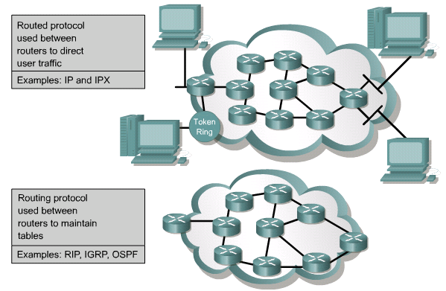

Slide 20
Autonomous systems
An autonomous system (AS) is a collection of networks under a common administration sharing a common routing strategy.
To the outside world, an AS is viewed as a single entity.

Slide 21
Autonomous systems (AS) provide the division of the global internetwork into smaller and more manageable networks.
Each AS has its own set of rules and policies and an AS number that will uniquely distinguish it from other autonomous systems throughout the world.

Slide 22
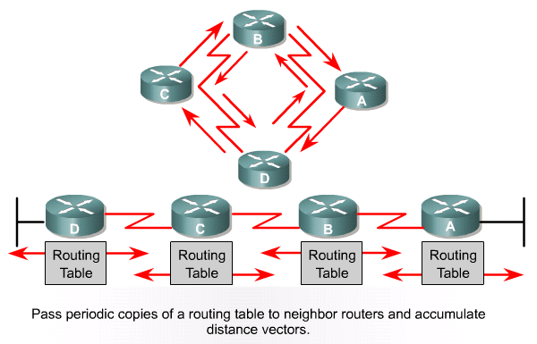
Distance vector routing protocol features

Slide 23
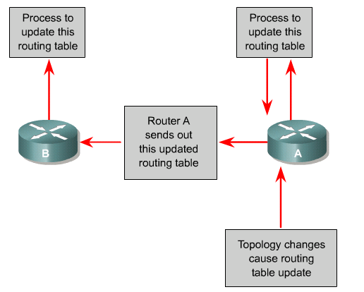

Slide 24
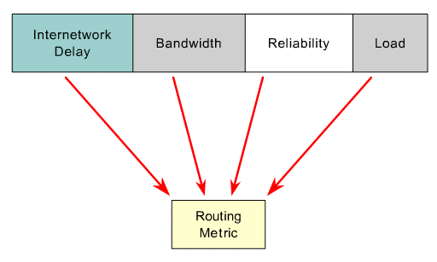
Link-state routing protocol features

Slide 25
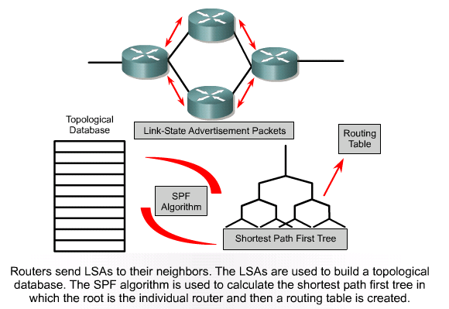
Link-state routing protocol features

Slide 26
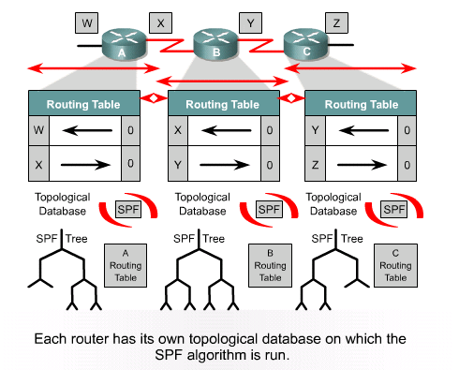

Slide 27
Routing configuration
Enabling an IP routing protocol on a router involves the setting of both global and routing parameters.
Global tasks include selecting a routing protocol, such as RIP, IGRP, EIGRP or OSPF.
The major task in the routing configuration mode is to indicate IP network numbers.

Slide 28
The router command starts a routing process.
The network command is required because it enables the routing process to determine which interfaces participate in the sending and receiving of routing updates.
An example of a routing configuration is:
    GAD(config)#router rip
    GAD(config-router)#network 172.16.0.0

Slide 29
Routing Information Protocol (RIP) was originally specified in RFC 1058.
Its key characteristics include the following:
  It is a distance vector routing protocol.
  Hop count is used as the metric for path selection.
  If the hop count is greater than 15, the packet is discarded.
  Routing updates are broadcast every 30 seconds, by default.

Slide 30
Interior Gateway Routing Protocol (IGRP) is a proprietary protocol developed by Cisco.
Some of the IGRP key design characteristics emphasize the following:
  It is a distance vector routing protocol.
  Bandwidth, load, delay and reliability are used to create a composite metric.
  Routing updates are broadcast every 90 seconds, by default.

Slide 31
Open Shortest Path First (OSPF) is a nonproprietary link-state routing protocol.
The key characteristics of OSPF are as follows:
  It is a link-state routing protocol.
  Open standard routing protocol described in RFC 2328.
  Uses the SPF algorithm to calculate the lowest cost to a destination.
  Routing updates are flooded as topology changes occur.

Slide 32
EIGRP is a Cisco proprietary enhanced distance vector routing protocol.
The key characteristics of EIGRP are as follows:
  It is an enhanced distance vector routing protocol.
  Uses load balancing.
  Uses a combination of distance vector and link-state features.
  Uses Diffused Update Algorithm (DUAL) to calculate the shortest path.
  Routing updates are broadcast every 90 seconds or as triggered by topology changes.

Slide 33
Border Gateway Protocol (BGP) is an exterior routing protocol.
The key characteristics of BGP are as follows:
  It is a distance vector exterior routing protocol.
  Used between ISPs or ISPs and clients.
  Used to route Internet traffic between autonomous systems.

Slide 34
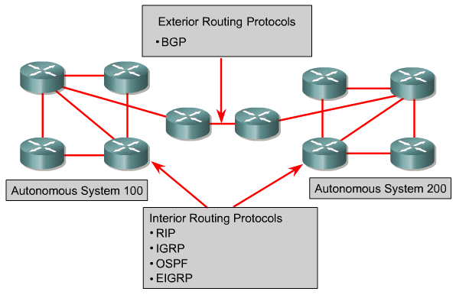

Slide 35
Autonomous systems and IGP versus EGP
Interior routing protocols are designed for use in a network whose parts are under the control of a single organization.
An exterior routing protocol is designed for use between two different networks that are under the control of two different organizations.

Slide 36
